Slide 1
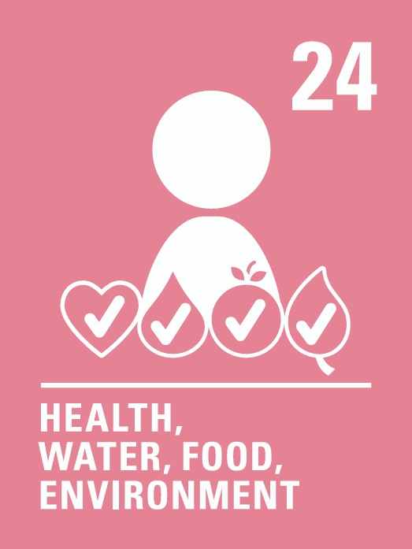


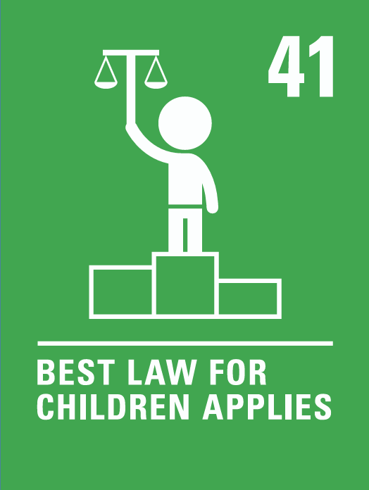
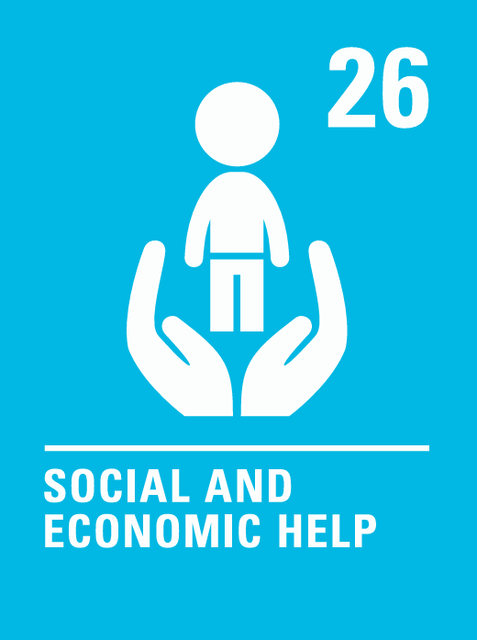
Coverage Spring 2 2024
Week | News Story | Focus Question | British Value Link | Protected Characteristics | UN Article
19th February | Coca‑Cola has announced it will temporarily be removing labels from Sprite and Sprite Zero drinks bottles to trial ‘label-less’ packaging. | How important is packaging? | Individual Liberty | Religion or Belief
26th February | In countries across Europe, including Romania, Belgium, France, Hungary, Poland and Greece, tractors have been blocking city streets and motorways as farmers protest against certain European Union (EU) rules. | How can you make your voice heard? | Democracy | Religion or Belief
4th March | Across the UK and Ireland, the charity, World Book Day, will be holding its annual celebration on Thursday 7th March. The day is a chance to celebrate and encourage reading in schools and homes. | How do you think World Book Day should be celebrated? | Mutual Respect and Tolerance | Age
11th March | Ministers have confirmed plans to ban the use of mobile phones in English schools and have released guidance for headteachers. The guidance is not statutory and offers schools different ways to introduce the ban. | Should mobile phones be banned in all classrooms? | Rule of law | Religion or Belief
18th March | Many families travelled to Glasgow for an event that claimed to channel the magic of Charlie and the Chocolate Factory. | What’s the best way to handle disappointment? | Individual Liberty | Religion or Belief
25th March | Poverty-fighting charity, Oxfam, recently released a new report on inequality and global corporate power. It found that the world’s five richest people have more than doubled their fortunes from a combined total of £321 billion to £688 billion since 2020. The wealth of the poorest 60% (nearly five billion people), has fallen. | Should there be a limit on how rich one person can become? | Individual Liberty | Sex
© Picture News 2024

